Slide 1


SIMATS ENGINEERING
SAVEETHA INSTITUTE OF MEDICAL AND TECHNICAL SCIENCES
Capstone project presentation
House price prediction
An AI-based approach to estimating residential property value from structured housing data
CSA1711-Artificial Intelligence
Presented by:
Guided By
Dr.K.KRISHNA KUMAR
A.P.GAUTHAM SINGH (192412007)

Slide 2


AIM
To design and develop an AI-based system that accurately predicts the market price of a house using key property attributes such as location, area, number of rooms, and amenities — enabling buyers, sellers, and real-estate platforms to make informed, data-backed pricing decisions.

Slide 3
OBJECTIVES
This project aims to transform raw real estate data into a clean and structured format, analyze key patterns and relationships, and apply advanced machine learning techniques to accurately predict property prices. It focuses on building a complete pipeline from data preprocessing to intelligent prediction, ensuring both accuracy and practical usability.

Slide 4
PROBLEM USED
House prices are influenced by numerous interdependent factors — location, size, condition, and market trends — making manual or purely intuition-based valuation inconsistent and unreliable. Traditional appraisal methods are time-consuming, subjective, and do not scale across large, diverse housing markets.

Slide 5

MODULE 1
Dataset Preparation & Organization
Data Collection
Source housing records (e.g. Kaggle House Prices / Boston Housing datasets) including price, area, location, and amenities.
Schema Definition
Identify and label features — numerical (area, rooms) and categorical (locality, furnishing status).
Structured, source-ready housing data
Data Consolidation
Merge multiple sources into a single structured table, ensuring consistent formats and units.
Collect → Organize → Structure → Store
Storage & Splitting
Organize data into training and testing sets, stored in accessible formats.

Slide 6
MODULE 2
Data Cleaning & Noise Removal
Overview
This module focuses on identifying and correcting errors, inconsistencies, and noise in the merged dataset.
Key Activities
Identifying and handling missing or incorrect values
Removing duplicate entries and inconsistencies
Detecting and removing noise and outliers
Standardizing formats (price, area, property details)
Outcome
A clean, reliable dataset ready for analysis

Slide 7
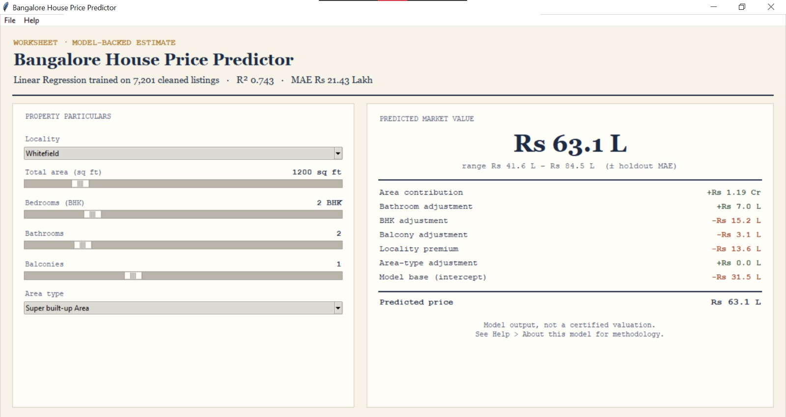
OUTPUT

Slide 8
CONCLUSION
A well-prepared and thoroughly cleaned dataset forms the foundation of an accurate house price prediction system. By systematically organizing raw data and removing noise, missing values, and outliers, the project ensures that the underlying AI model can learn genuine pricing patterns rather than data artifacts — resulting in more reliable, trustworthy predictions that support smarter real-estate decisions.
01
Clean Dataset
02
Trained Model
03
Reliable Price Prediction

Slide 9
References
Kaggle, "House Prices - Advanced Regression Techniques" Dataset, kaggle.com/competitions/house-prices-advanced-regression-techniques.
Harrison, D. & Rubinfeld, D.L. (1978). Hedonic Housing Prices and the Demand for Clean Air. Journal of Environmental Economics and Management.
Russell, S. & Norvig, P. (2020). Artificial Intelligence: A Modern Approach (4th ed.). Pearson.
Han, J., Kamber, M., & Pei, J. (2011). Data Mining: Concepts and Techniques (3rd ed.). Morgan Kaufmann.
McKinney, W. (2010). Data Structures for Statistical Computing in Python. Proceedings of the 9th Python in Science Conference.
Géron, A. (2019). Hands-On Machine Learning with Scikit-Learn, Keras, and TensorFlow (2nd ed.). O'Reilly Media.

Slide 10


